Slide 1
Robotic Control: A Case Study on Self-Balancing Systems
Arelia McKern | Magdalena Janocha
Supervisor: Prof. Geimer
Project Leader: Bobo Helian

Slide 2
Why Self-Balancing Robots are a Control Benchmark
Self-balancing robots are inherently open-loop unstable
Small disturbances, sensor noise or delays immediately affect stability
Successful control requires fast, closed-loop feedback and robust tuning
This makes the system an ideal benchmark for → real-time control → sensor integration → simulation-to-hardware transfer
Project Goal: Stabilize the robot and extend balance to functional behavior
Notes:
Self-balancing robots are a paradox: They are mechanically simple — yet dynamically highly unstable.
A deviation of a few degrees is enough to make the system fail. This makes them an ideal benchmark for real-time control, sensor fusion and robust closed-loop design.

Slide 3
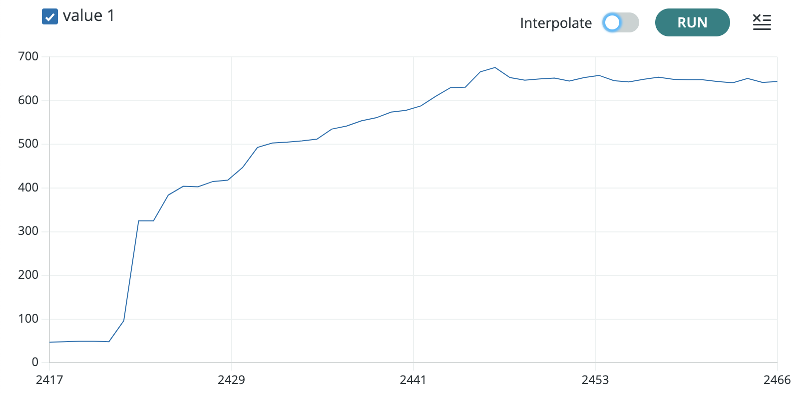
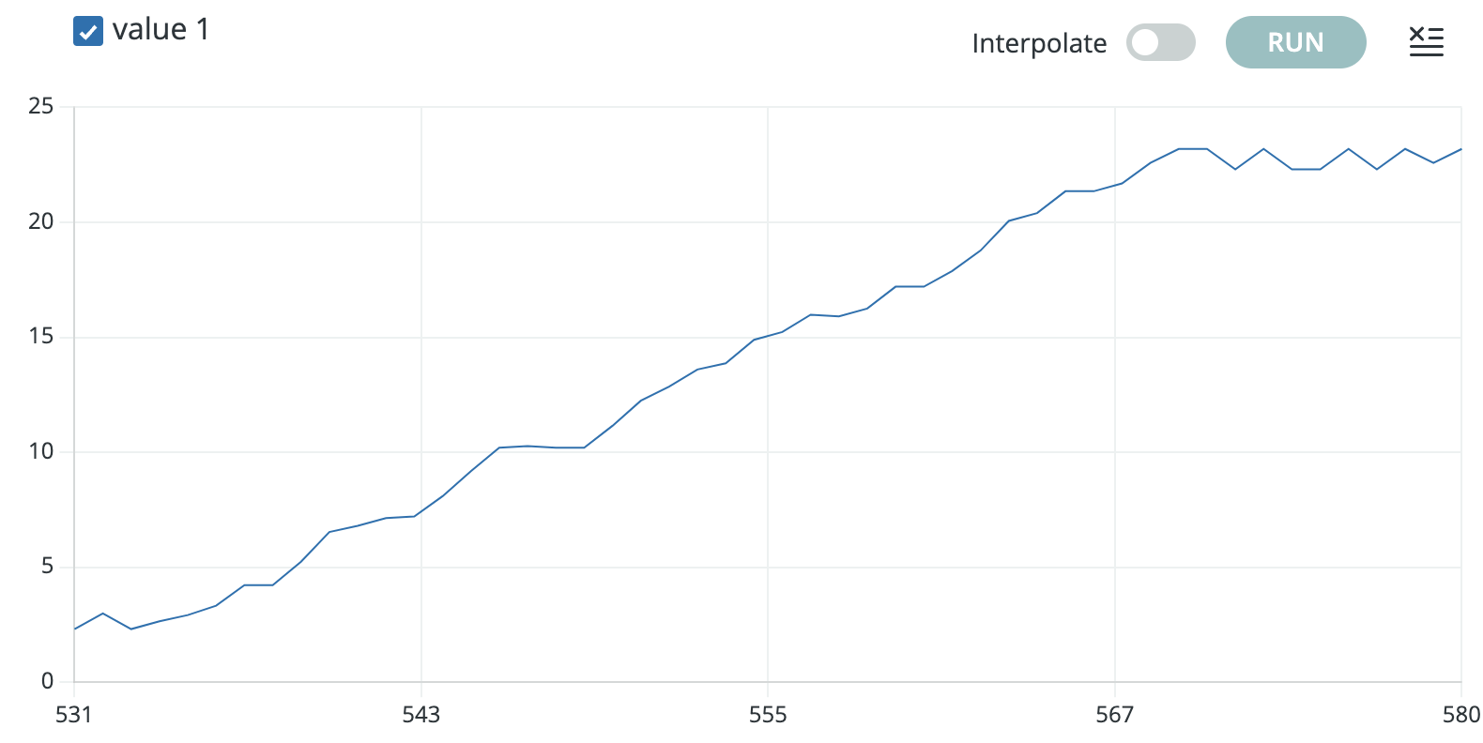
Hardware – Sensor tests
IR-Sensor (Line Sensor) Ultrasonic Sensor
Notes:
First – tested Sensors: For path and navigation really important IR Sensor (Line Sensor):
Sensor response analyzed with respect to distance to the ground
Optimal operating height identified at approximately 10 mm
Mechanical shielding added → reduced influence of ambient light and external light sources
Black paper moved underneath the sensor to simulate a path
Clear distinction between light and dark surfaces achieved
Ultrasonic Sensor:
Measurements performed along a known, measured distance
Tests with a moving object to simulate obstacles
Evaluation of signal dynamics, noise and measurement behavior
Basis for collision detection and obstacle avoidance
Sensor characterization provides reliable inputs for subsequent control tasks

Slide 4
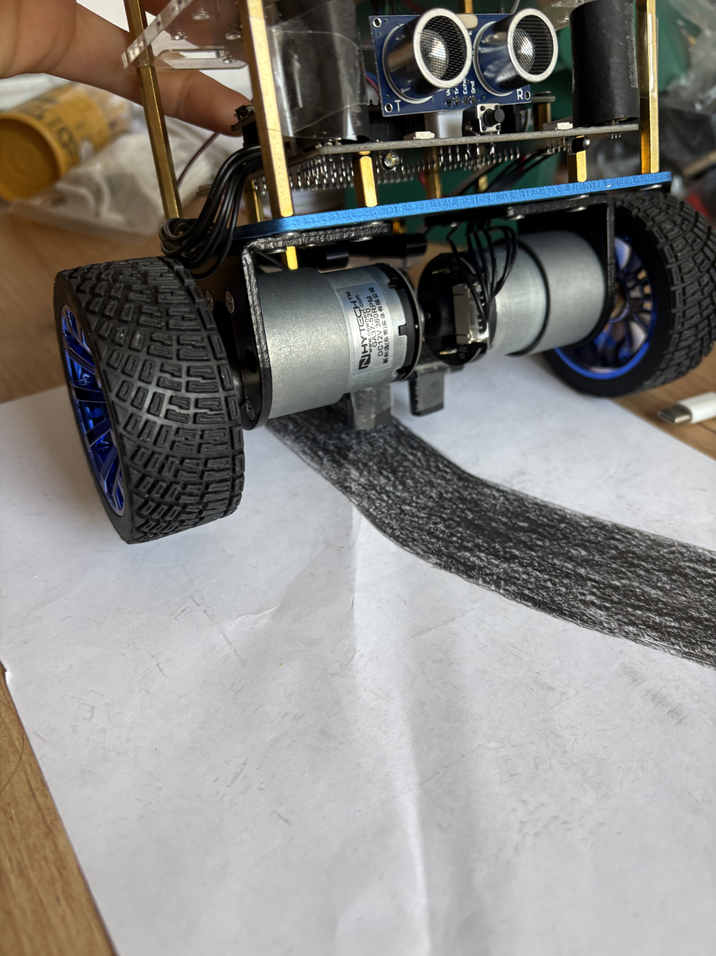
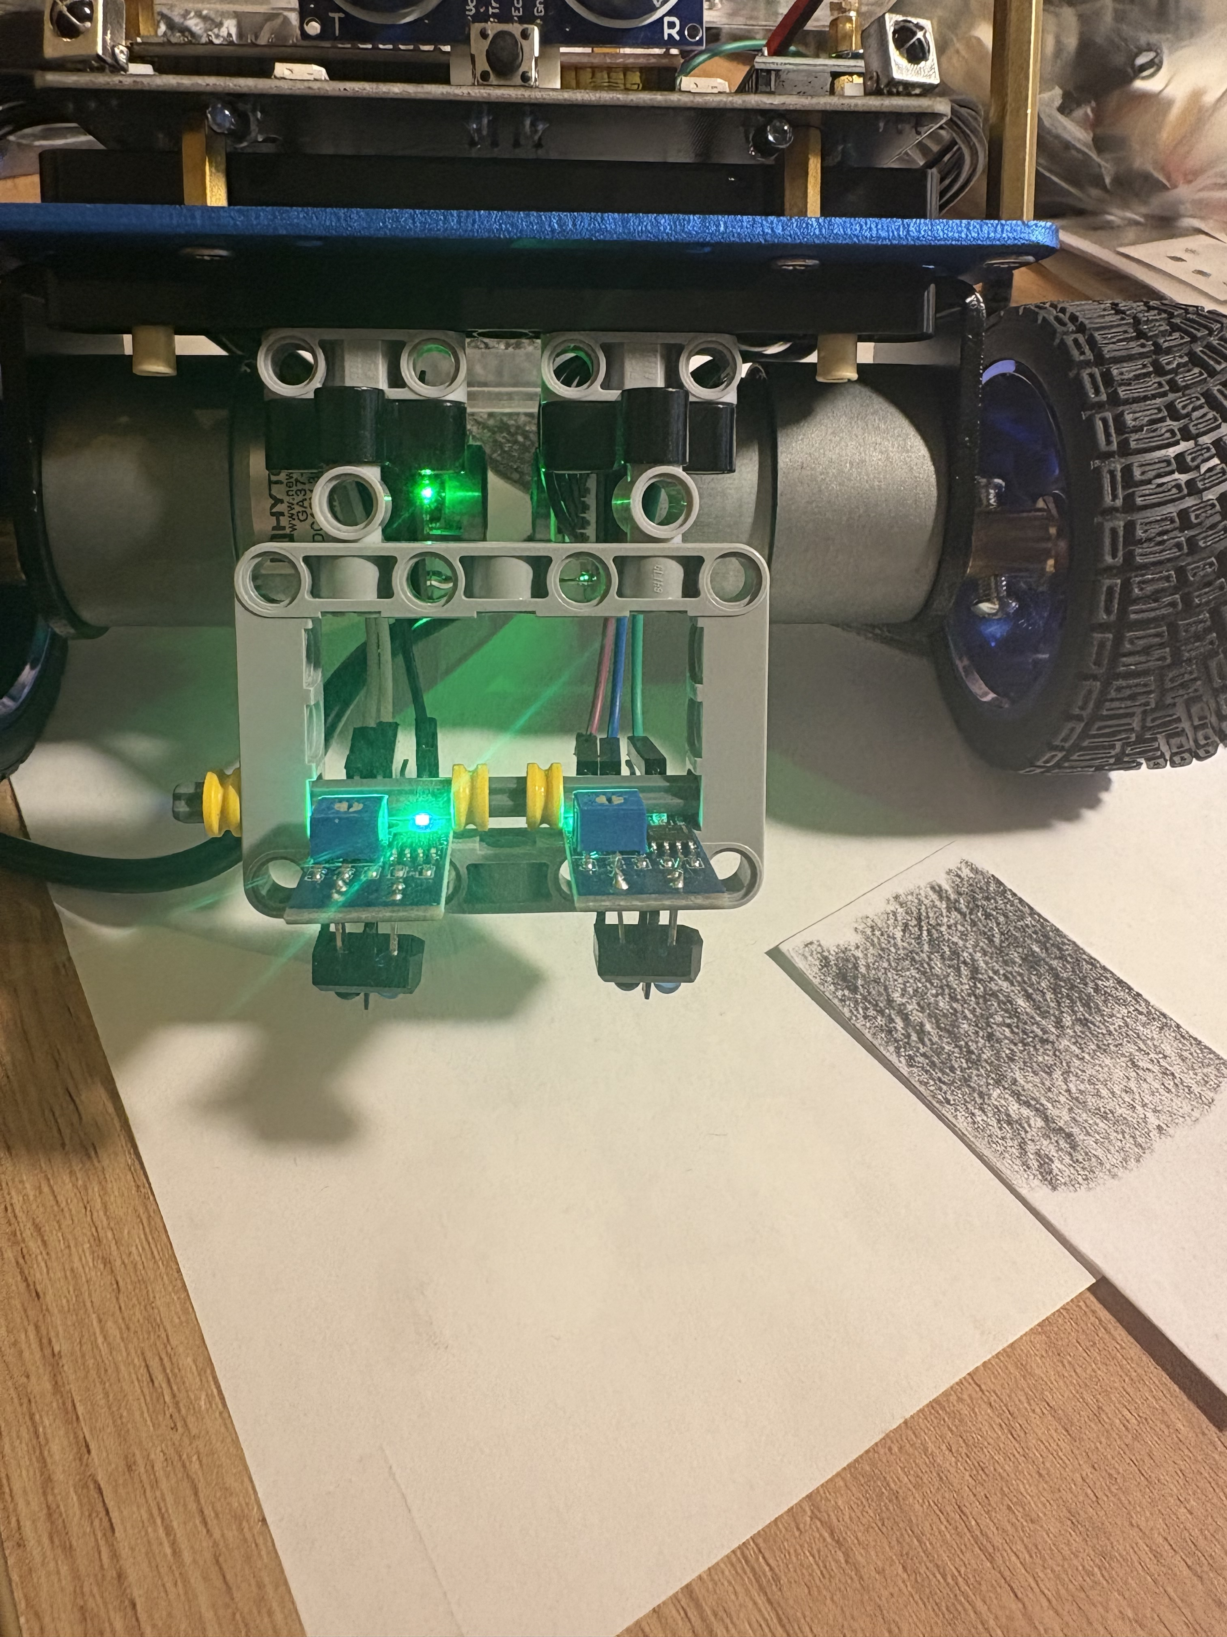
Hardware
Mounting bracket for TCRT 5000 (Rapid Prototyping with LEGO)
Notes:
Rapid prototyping approach using LEGO mounting brackets
Allowed fast iteration and flexible adjustment of sensor position and height
Prototype 1: Sensor between the wheels / inside the track
Pros:
Sensor closely aligned with robot center of mass
Less influence from steering motions
Compact and mechanically protected
Cons:
Limited field of view
Short reaction time at higher speeds
Less suitable for anticipating sharp curves
Prototype 2: Sensor mounted further forward
Pros:
Earlier detection of the line
Better anticipation of curves and path changes
Smoother trajectory tracking possible
Cons:
Higher sensitivity to vibrations
Stronger influence of pitch motion
More exposed to collisions and uneven ground
---> outside of the line because of the distance of 0.5cm Lego

Slide 5
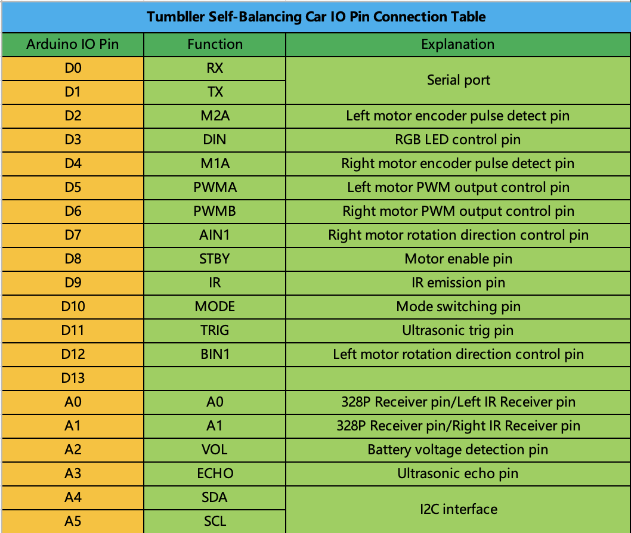
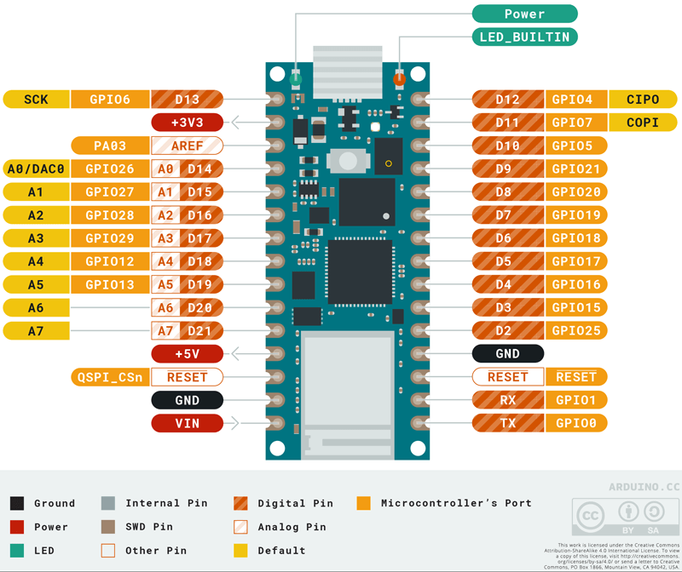
Hardware
Notes:
A0 A1 belegt
A6, A7 wären frei, sind halt aber nicht erreichbar, deswegen IR neben Ultraschall weg

Slide 6
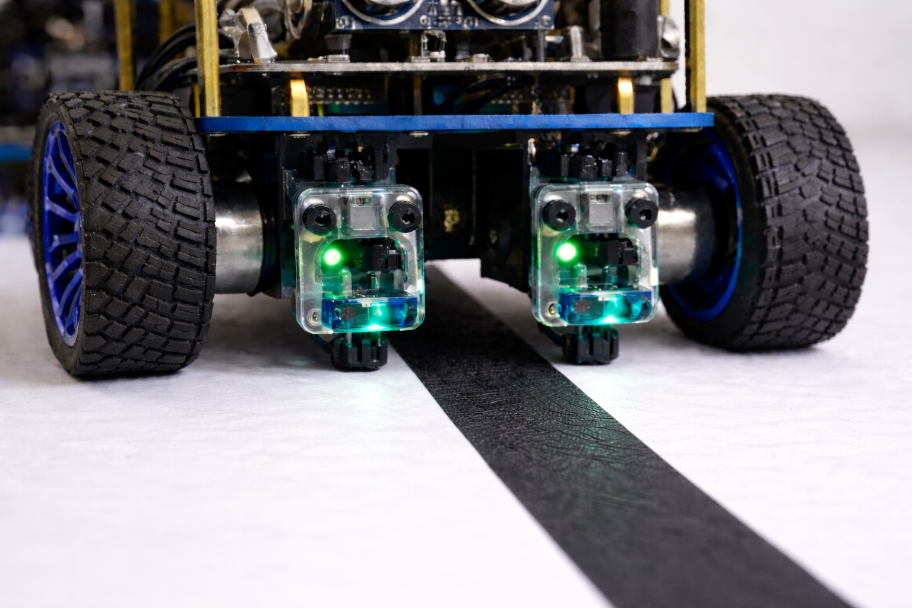
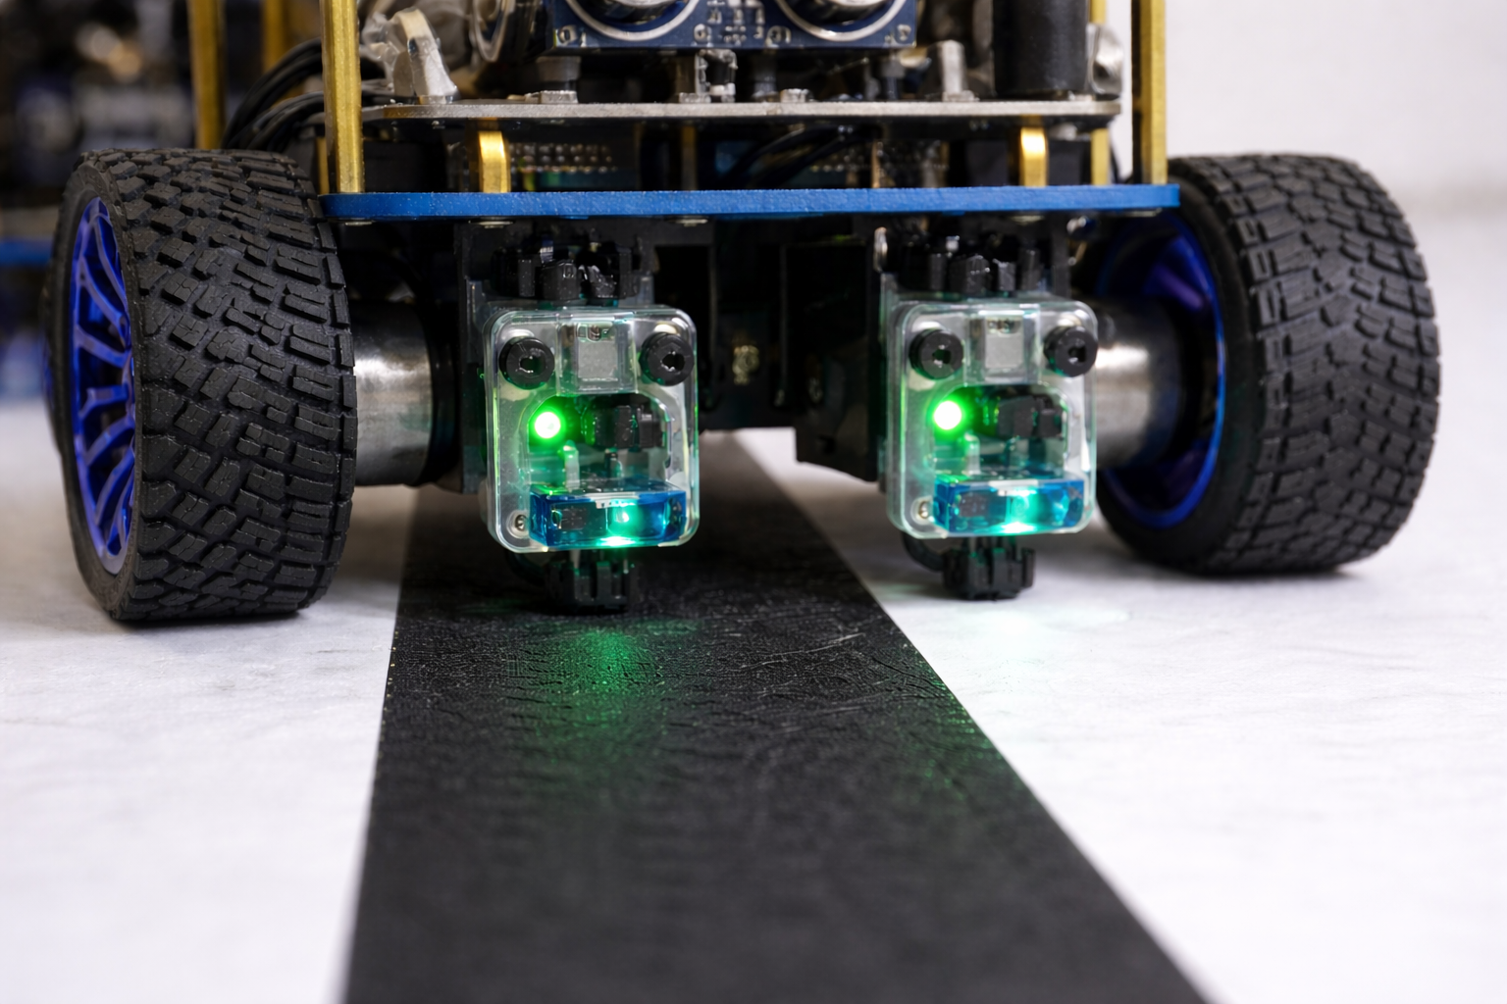






Hardware - Outlook
Notes:
Beide Sensoren auf Kante
Einer drauf, der andere Daneben

Slide 7
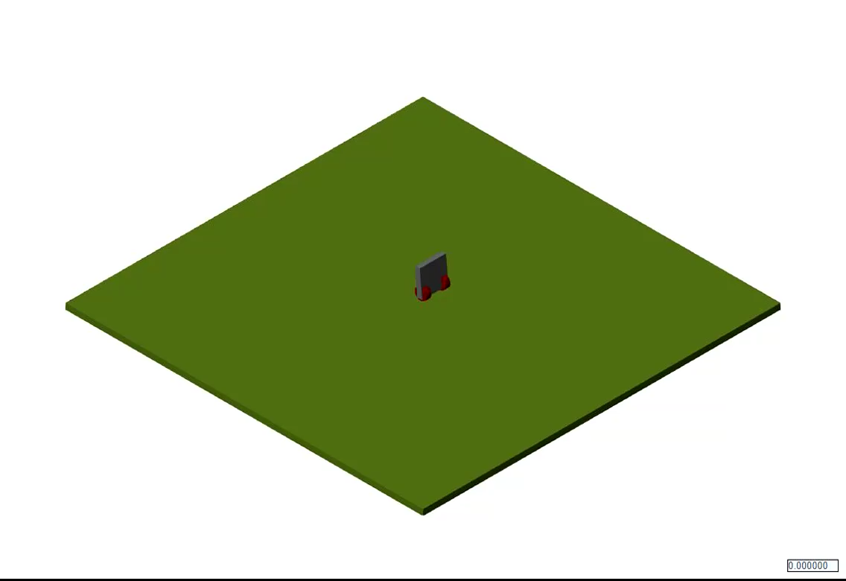
Simulation demo

Slide 8
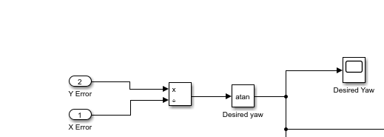
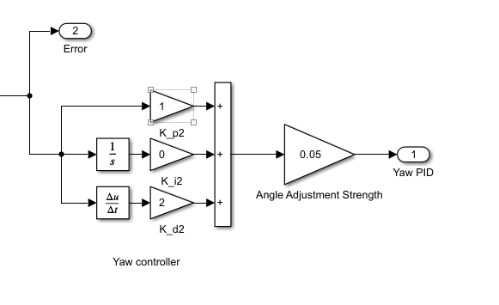
Simulation demo

Slide 9
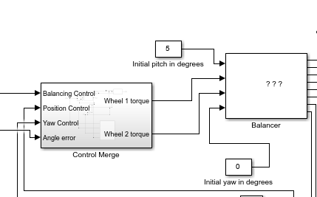
Simulation demo

Slide 10
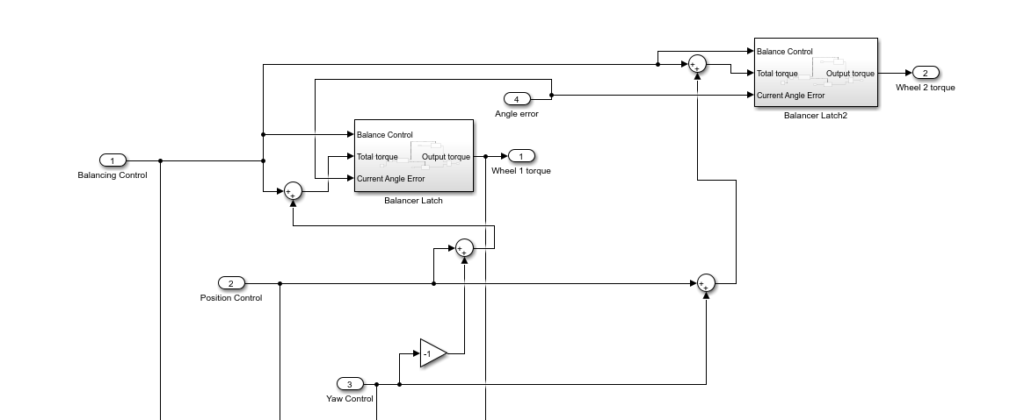
Simulation demo

Slide 11
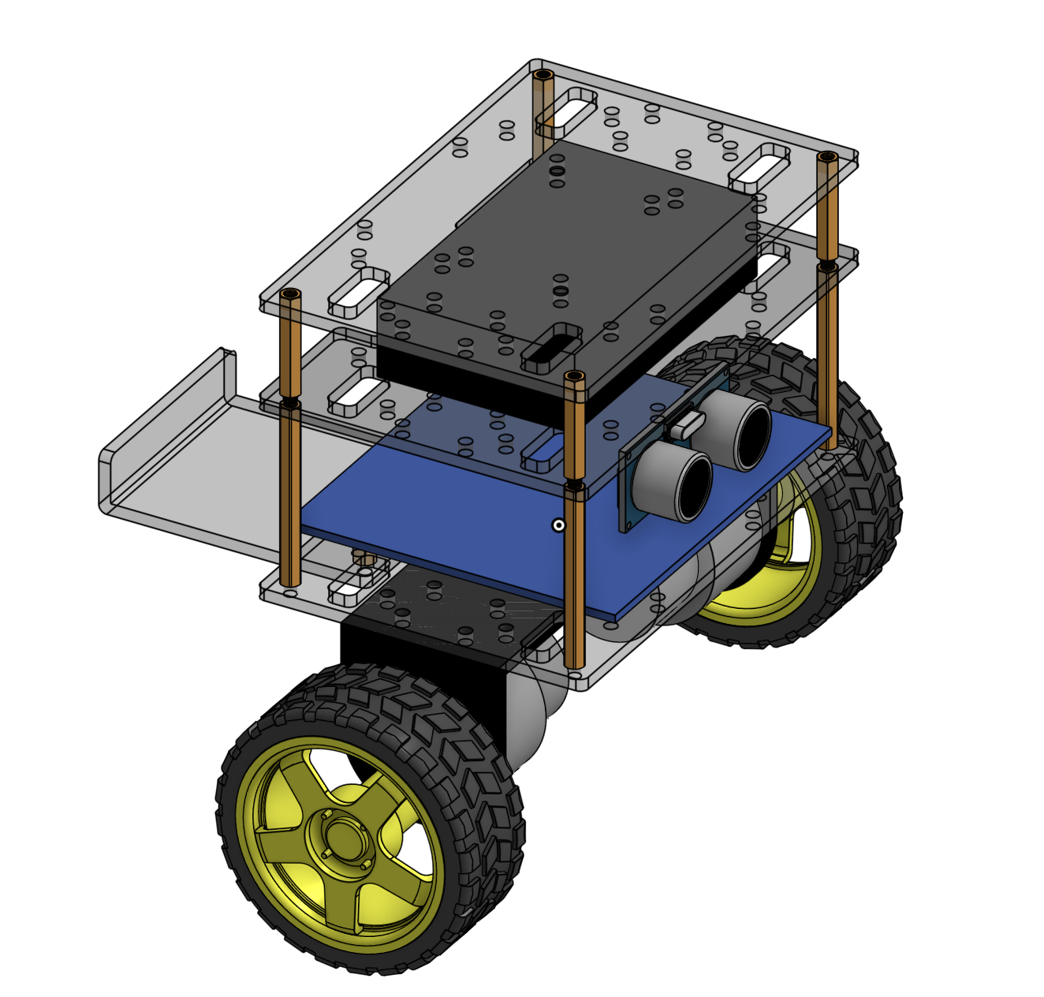
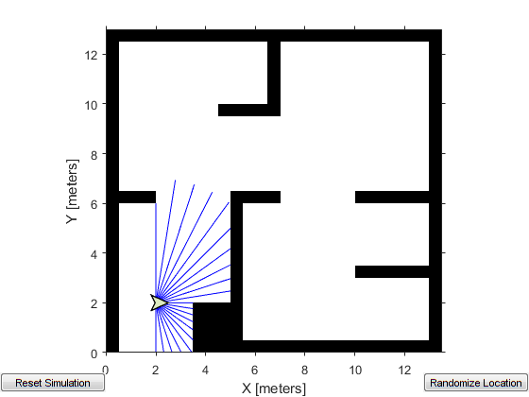
Simulation Outlook

Slide 12
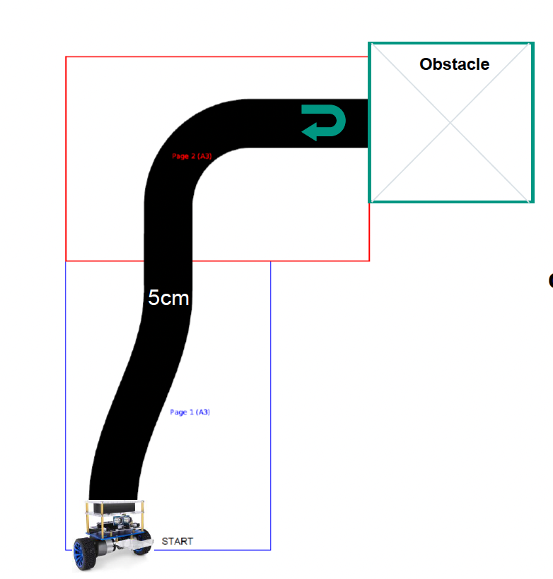
Task 1
Notes:
Zeitsteuerung beim Obstacle, blaue LEDS zeigen Detektion
Regler bisher einfach cases

Slide 13
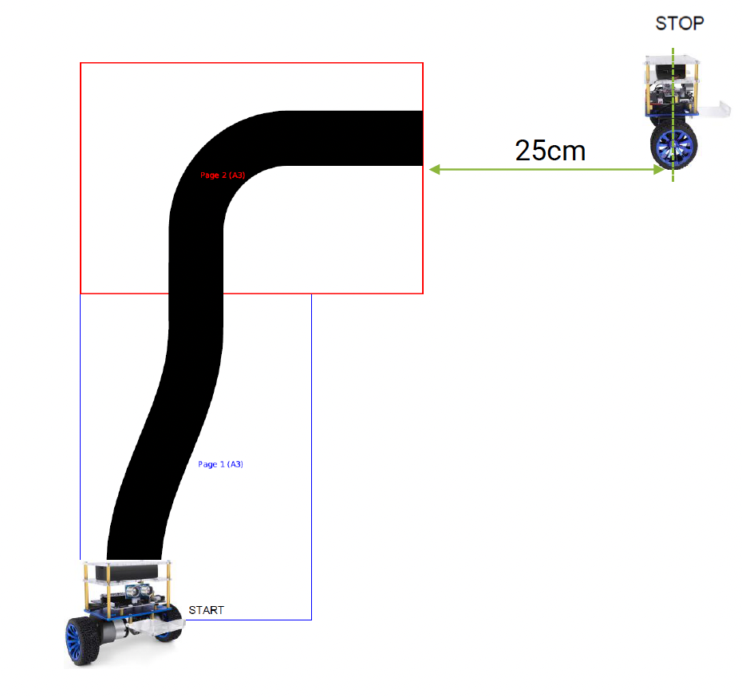
Task 2
Notes:
Erkennen das ende der linie nicht, wird geschaut, wann wird das letze mal schwarz gesehen haben, wenn zu lange her, dann blaue leds und encoder blaue LEDs

Slide 14
Thank your for your attention!

Slide 15
Backup

